Slide 1
N E E D F I N D I N G
PETER HANSEL, NIK MARDA, JASON PRINCE, WILLIAM YIN

Slide 2


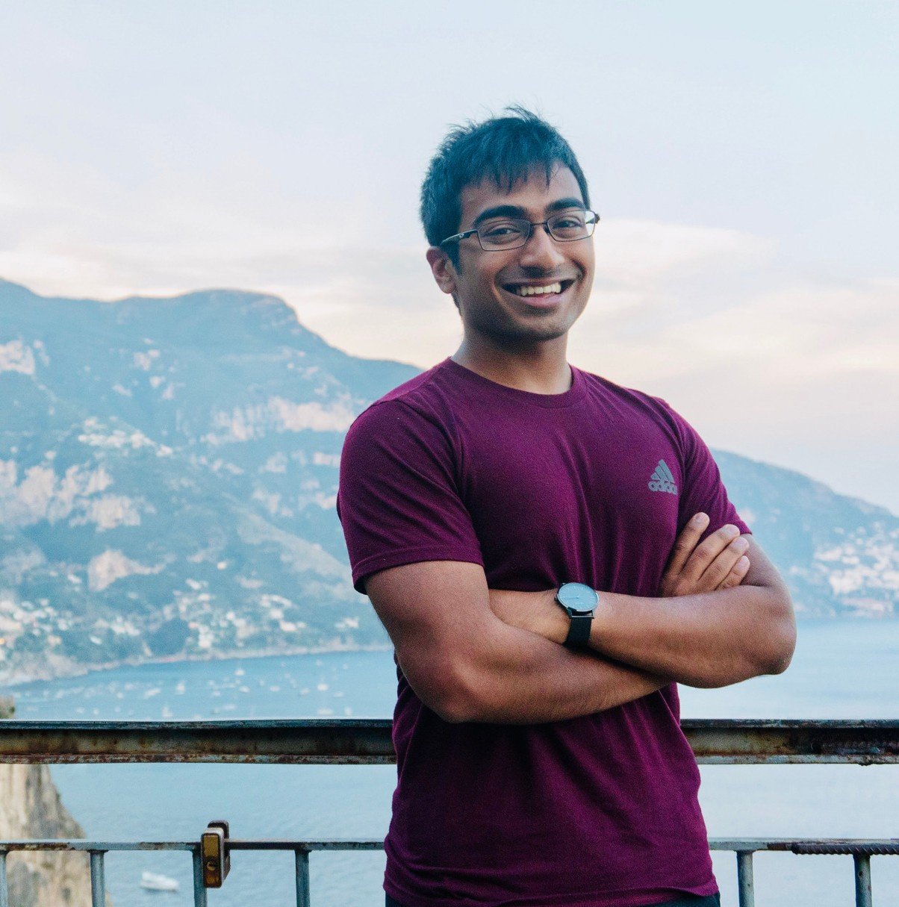
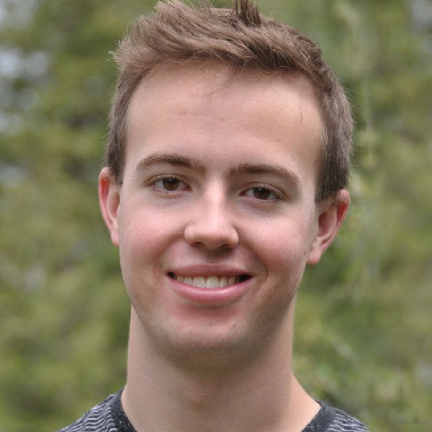
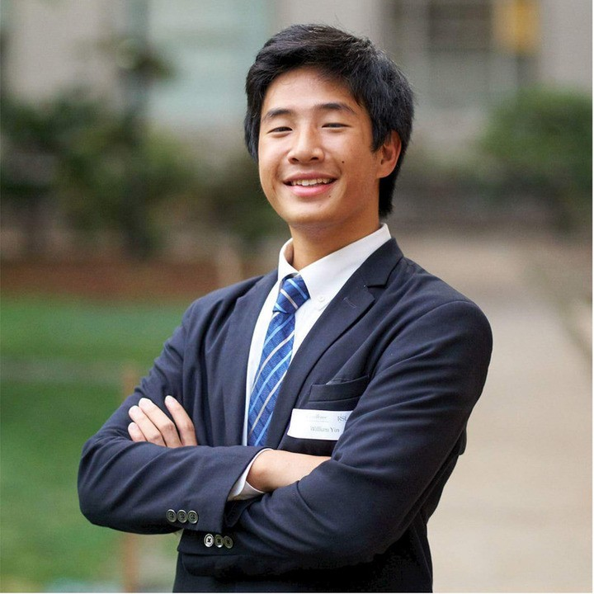
T E A M M E M B E R S
PETER HANSEL
NIK MARDA
JASON PRINCE
WILLIAM YIN
CS/ MATH + MUSIC CLASS OF 2021
CS/ MATH + POLISCI CLASS OF 2021
SYMBOLIC SYSTEMS CLASS OF 2019
CS/ MATH + NEURO CLASS OF 2021

Slide 3
I D E A & G O A L
M A N A G E M E N T

Slide 4
H A R D T O P R O C E S S
MOST IDEAS ARE FORGOTTEN IN 48 HOURS
Remembered*
30%
Forgotten*
70%
*approximately - see research on Ebbinghaus' Forgetting Curve

Slide 5
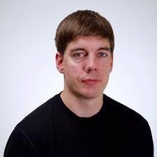
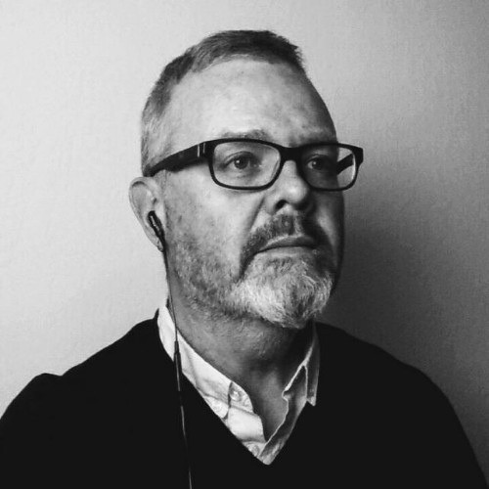
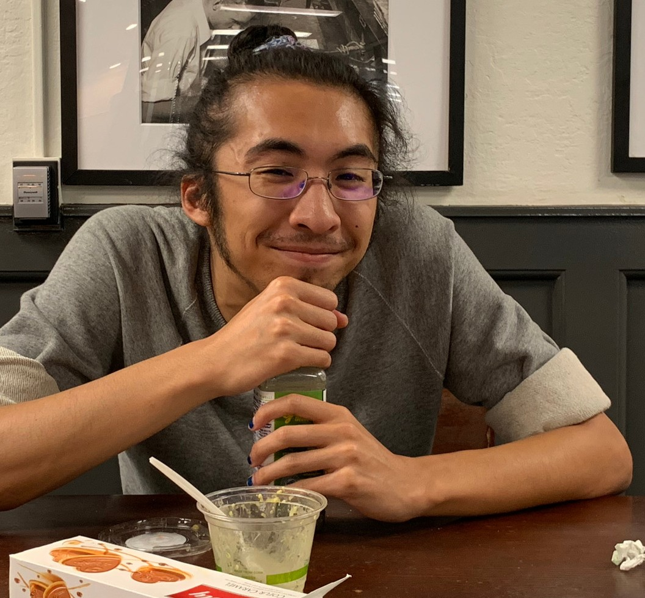
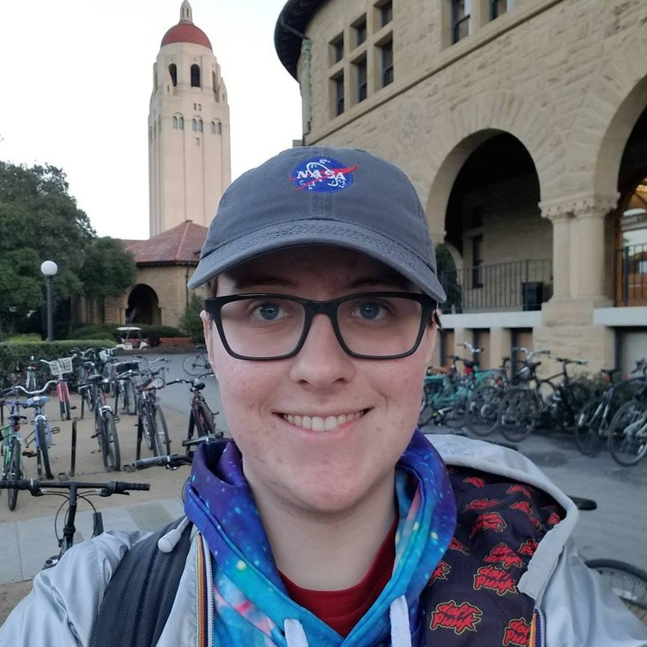
W H O W E I N T E R V I E W E D
MARK WHITING
BILL COCKAYNE
EDDY
JACOB RAY
HCI POSTDOC @ STANFORD
TECH EXECUTIVE & INVENTOR
BIOCOMP RESEARCH @ STANFORD
EE/ CS STUDENT @ STANFORD' 21

Slide 6
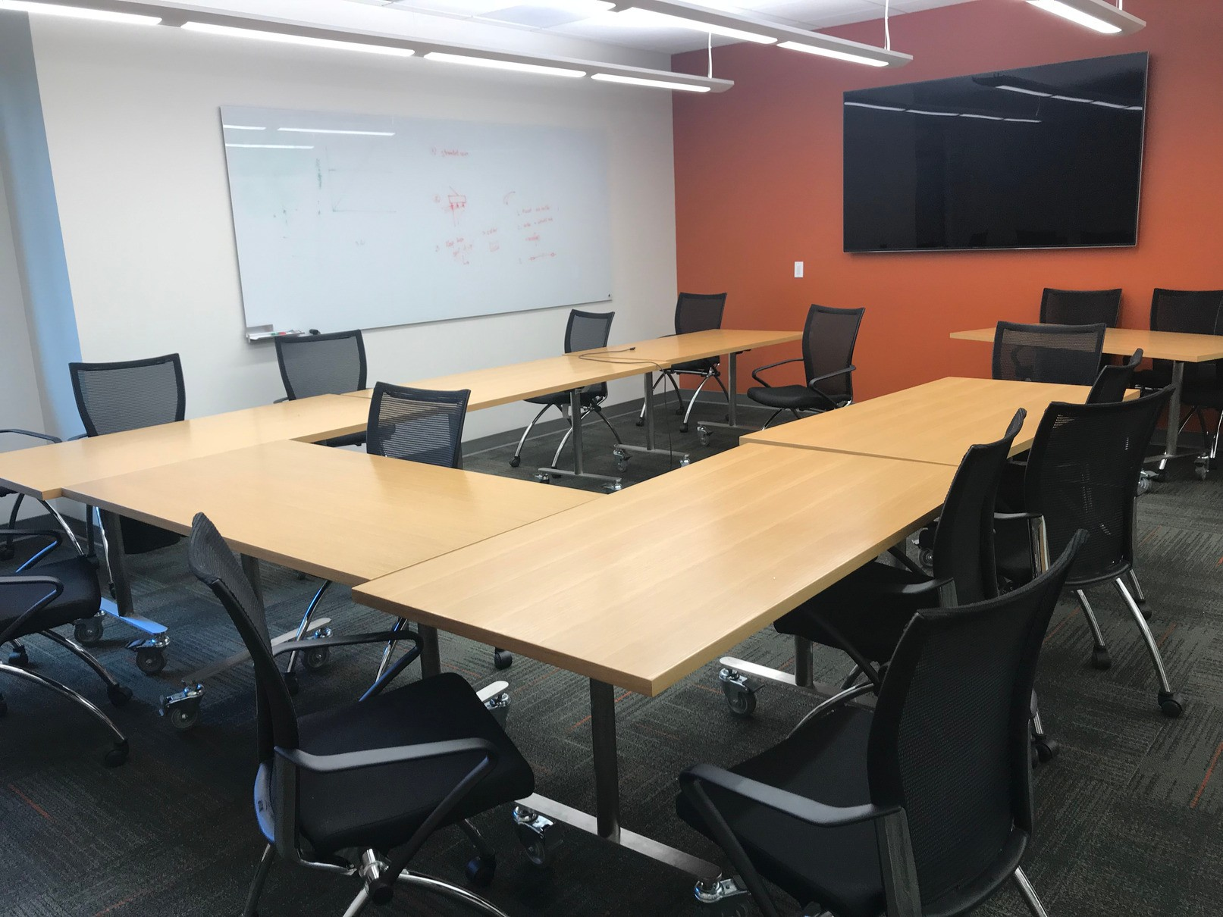
M A R K W H I T I N G
HCI Postdoc Studies creative decisions
Had mentioned idea management Gates 358 (Conference room)
Asked about:
His current idea system What he wished he had Why he thinks others failed

Slide 7
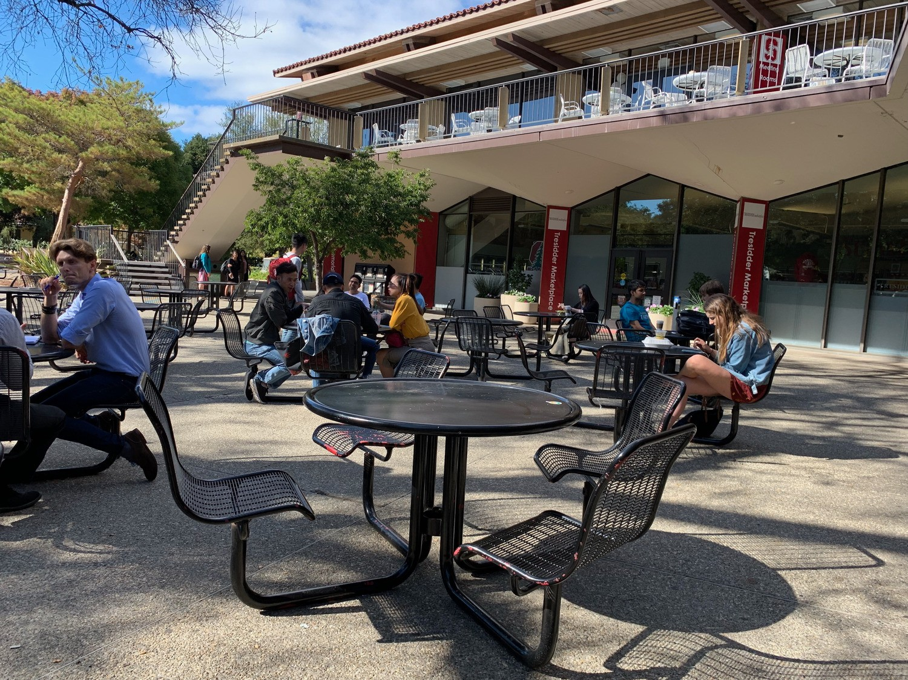
B I L L C O C K A Y N E
Tech executive & innovator Consults about innovation Teaches the ideation process Tressider Memorial Union
Asked about: Fleshing out ideas & goals
History of this problem How businesses manage ideas

Slide 8
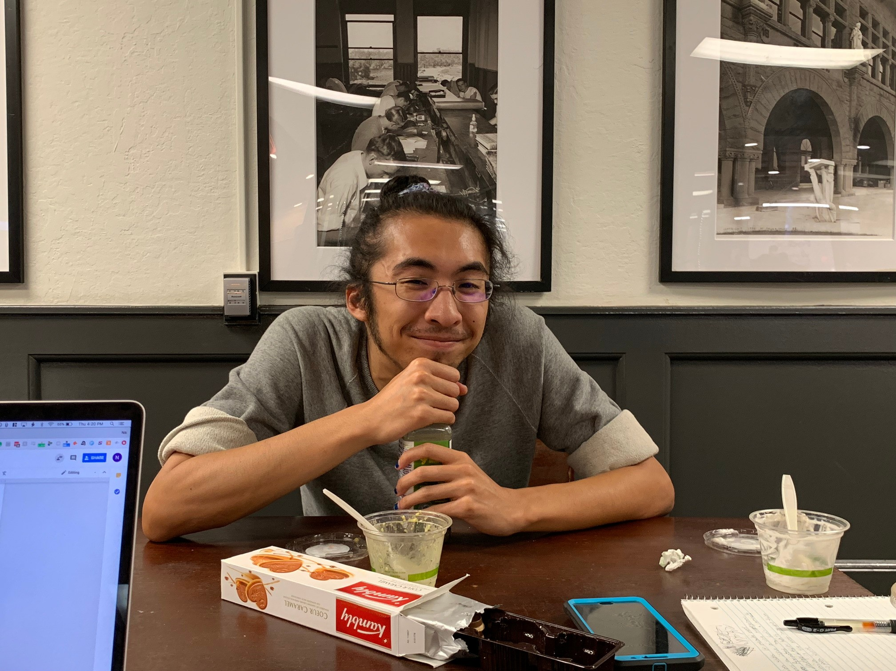
E D D Y
Works in computational biology lab Between FedEx and Treehouse
Asked about:
How he manages goals in a creative setting His aversion to tech productivity solutions

Slide 9
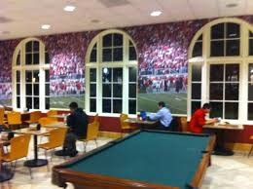
J A C O B R A Y
Stanford Student '21 Studies EE/CS
Has lots of engineering ideas The Axe and Palm
Asked about: Finding relevant information How he manages his busy life
What works for him now?

Slide 10
R E S U L T S
MARK WHITING
BILL COCKAYNE EDDY
JACOB RAY
EXTREME USER
EXTREME USER
NON- USER
AVERAGE USER
WRITES IDEAS IN IOS NOTES
HAS TRIED EVERYTHING
PROCESSES IDEAS IN HIS HEAD
DOESN' T HAVE PERMANENT SETUP
^ IN MEETINGS TOO
VALUABLE IN BUSINESS ( OKR)
VIEWS TECH AS A DISTRACTION
WANTS TO SEE RELATED IDEAS FOR A GIVEN GOAL
WANTS IT TO ASK LEADING QUESTIONS
SMART REMINDERS FOR GOALS
" I DON' T WANT SOMETHING ELSE TELLING ME WHAT [ I ' M] THINKING"
" USING DUE DATES AS REMINDERS SEEMS WRONG"
"[ I ' LL] WANT TO REMEMBER, BUT I DON' T KNOW WHEN"
" MEASURE WHAT MATTERS"

Slide 11
E M P A T H Y M A P
Say
"Writing down next steps serves as a gut check"
“[Tracking ideas] gives me the heeby-jeebies”
"I hate not being able to switch into a different application"
"Make me do the least amount of work"
"Management is like 'weren't we working on this five years ago?' And the answer is yes"
“It’s not that I care what I wrote - only what it made me feel”
"I often forget to process [my ideas] every Sunday like I planned to"
Think
"No external tool can address my own shortcomings"
"I want to record more of my thoughts"
"Anything I forget just wasn't important enough to remember"
"I could be more creative if I had a computer processing my thoughts and finding connections between them"
"Businesses could avoid having things slip through the cracks"
"Maybe I'll achieve some of my bucket list items if I'm constantly reminded to do them"

Slide 12
E M P A T H Y M A P
Do
Laughed when asked if calendar reminders to work on a project help
Eyes widened at the idea of being able to see related notes when typing a new one
Cringed at the idea of software knowing his thoughts better than him
Smirked at the prospect of Evernote making their product better in the next five years
Rolled eyes about his own note-taking habits
Pulled out phone to show us a mental health app with a beautiful UI/UX
Feel
Confident in own systems, but a little unsatisfied with not reaching full potential
Annoyed that they can't find their old ideas
Freaked out by tech that "learns" the user
Frustrated that they don't accomplish items on their bucket list
Tired of tech with transition costs larger than the productivity boosts
Constantly annoyed at setting multiple reminders to start on a project

Slide 13
S U R P R I S E S
No one had an idea management system they really l iked, though most of them looked for one
# 1
_{# 2} All of them used some form of
repeated preemptive reminders
# 3
The boundary between " idea" and " goal" i s often fuzzy

Slide 14
K E Y P R O B L E M S
Multiple interviewees wanted something that...
_{# 1} . . . processed their thoughts with l imited user input
# 2
# 3
. . . reminded them of ideas/ goals periodically and intelligently
. . . captured information quickly without r igid input structure

Slide 15

I N S I G H T S & N E E D S
People want to capture their ideas and goals quickly
The backend should do a lot of the processing
There should be scaffolding to help the user develop ideas
Smart reminders for goals
could be powerful i f done r ight

Slide 16

Q U E S T I O N S
How do you design for people sharing only the same core problem?
How can you seamlessly integrate
" ideas" and " goals" into one platform?
Where would the backend get info to process ideas i f the input i s f reeform?
When should " smart reminders" pop up and how should they be set up?

Slide 17
Q U E S T I O N S ?

